Slide 1

Working
from Home
The New Reality

Slide 2
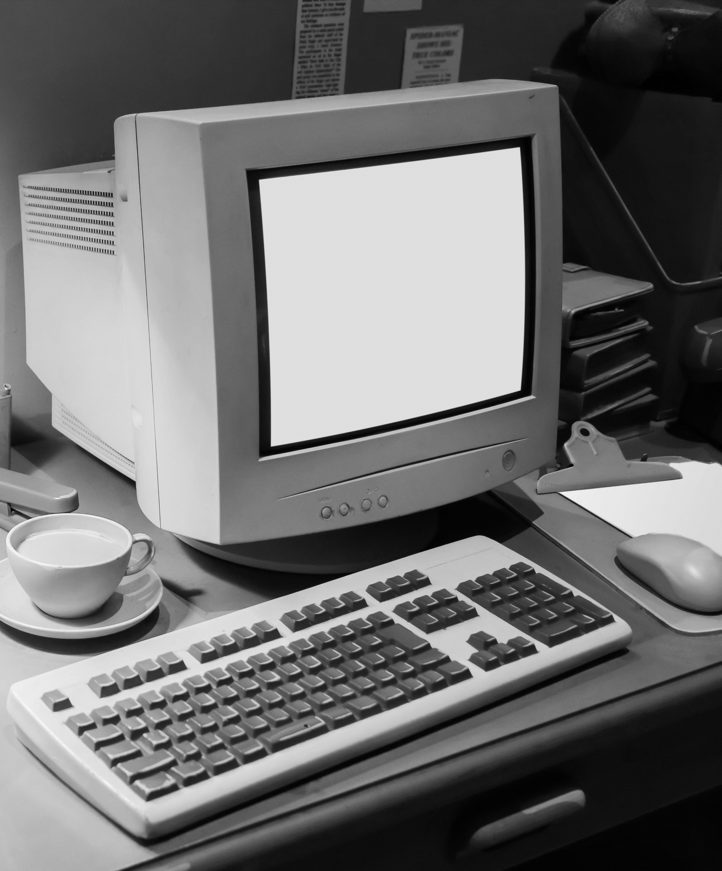
Telework | A little history
Telework or Telecommuting is a concept that has been around since the 1960s when a programmer working for the Defense Advanced Research Projects Agency (DARPA), the precursor to the Internet was going to resign his position to stay home with his pregnant wife. He was persuaded not to resign and instead installed a teletype machine in his home and continued to program from there.
Then in 1970s, Jack Nilles was working remotely on a complex NASA communication system and coined the word “telecommuting.” He went on to coauthor The Telecommunications-Transportation Tradeoff, which proposed working from home as a solution to traffic, pollution, as well as limited resources.
As access to technology and high-speed internet became available to more people, there has been an exponential growth of people working from home occasionally and those moving to a full teleworking model. A study in 2017 found that 47% of Canadian employees work from outside one of their employer’s main offices for half the week or more. (Regus Canada)
In 2020, the global pandemic further pushed more companies to allow their employees to work from home. Many analysts believe that based on historical trends, that those who were working remotely before the pandemic, will increase their frequency after they can return to their offices. For those who were new to remote work until the pandemic, we believe there will be a significant upswing in their adoption.

Slide 3
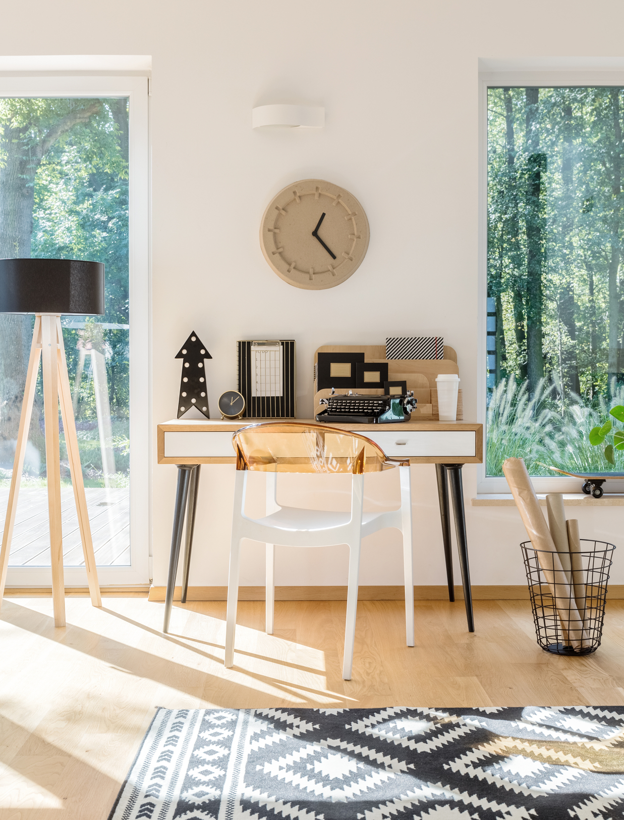
Working from home opens up new lifestyle opportunities
“On lake and on sea, upon soaring mountain tops and on expansive farmlands, many Canadians are embracing a bold, new work-from-home doctrine: 'I can live anywhere in this huge land'”
Royal LePage Report - 2020
Over the last 20 years, real estate costs in urban centres have consistently been on the rise. In recent years, the markets in the GTA have increased so significantly that many people have been unable to find a home within their price range. This started the trend of city dwellers moving to smaller communities and country homes.
The global pandemic expedited this trend significantly. More people learned that their jobs could be done from home but also highlighted their current homes’ shortcoming and space.
According to Royal LePage 2020 Report, the aggregate price of a single-family home in Canada's recreational market increased 11.5% and the aggregate price of a waterfront property increased 13.5%. They also forecast that the price of a recreational property in 2021 will increase 8% year-over-year.
With increase demand and limited supply of these types of properties, developers have started providing rural locations that have all the connectivity and amenities that consumers expect. This gives home buyers all the benefits of living rurally while keeping some of their urban conveniences.

Slide 4

Benefits & Challenges
Teleworking has mainly been a positive experience for employers and employees, yet it still has a few disadvantages.
PROS
CONS
Work Life Balance
In many cases, working from home can help you foster your work-life balance by allowing you to schedule your work around your personal life. Working remotely can afford you more time in your home to take care of essential tasks that benefit your lifestyle.
Increases satisfaction
Not only are you able to make decisions independently, but you can also work comfortably without the worry of office-related stress, interruptions or other challenges you might find in a traditional workplace. This can have a direct influence on your overall job satisfaction.
No Commute & Reduced Expenses
Work-from-home jobs mean you can eliminate your commute. Even if you work from home one or two days during the week, you travel less. This can reduce your fuel and transportation expenses. Telecommuting can also help you reduce other expenses like work clothing, meals and even childcare.
Home office costs
Some remote positions require specific equipment like headsets, webcams or software to perform essential tasks and projects. If you want to set up a desk, chair and other furniture, you can expect to cover some initial costs to get your home office organized
Not having a private or quiet office space
It is not common in most residential building designs to include 1 or 2 home office spaces. As a result, many people end up using an important bedroom space or setting up their office in a common area where they will likely be distracted.
Distractions at Home
Distractions like the television, pets or household chores can affect how you perform your job. Too many distractions can lead to a decrease in your productivity and motivation. You can avoid this by setting up your home office in a separate area.

Slide 5


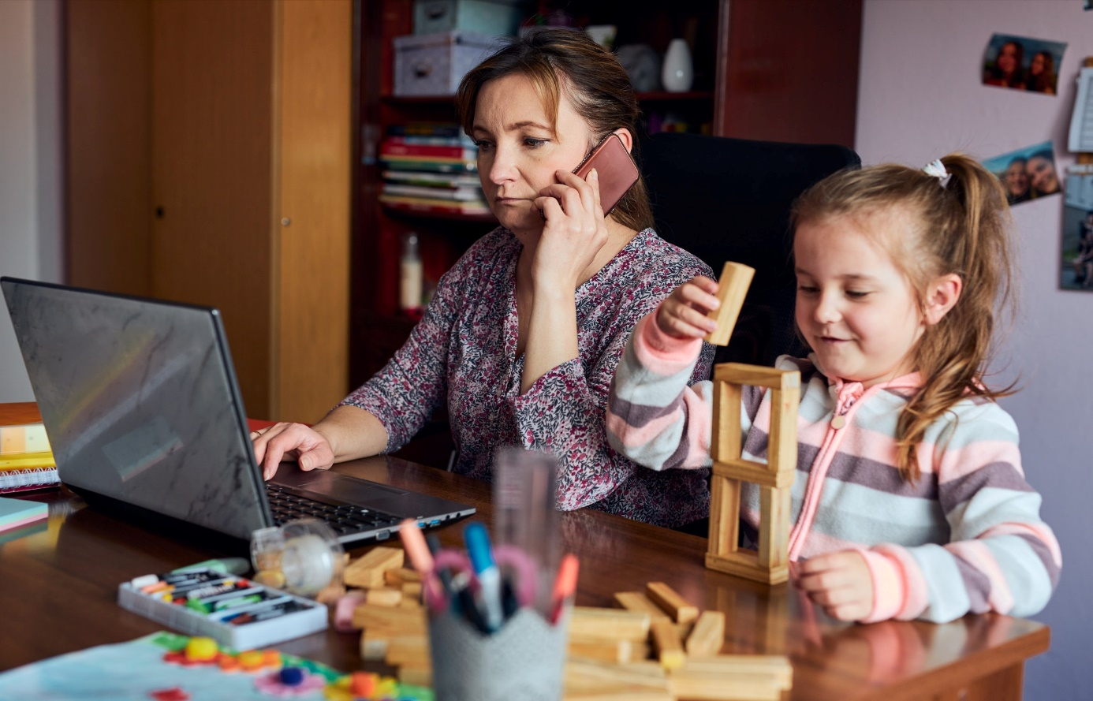
Home Office Considerations
Many employees are excited by the prospect of teleworking because of all the benefits. Yet some considerations should be made to ensure the space is set up to maximize productivity
Ask yourself these questions before you begin:
What will you be doing in the space?
What type of work needs to be done?
Will external clients be visiting the space?
Will colleagues visit for collaborative work?
What type of equipment is required?
When will I be doing the bulk of my work?
Will I be making conference calls?
Will I be video conferencing?

Slide 6
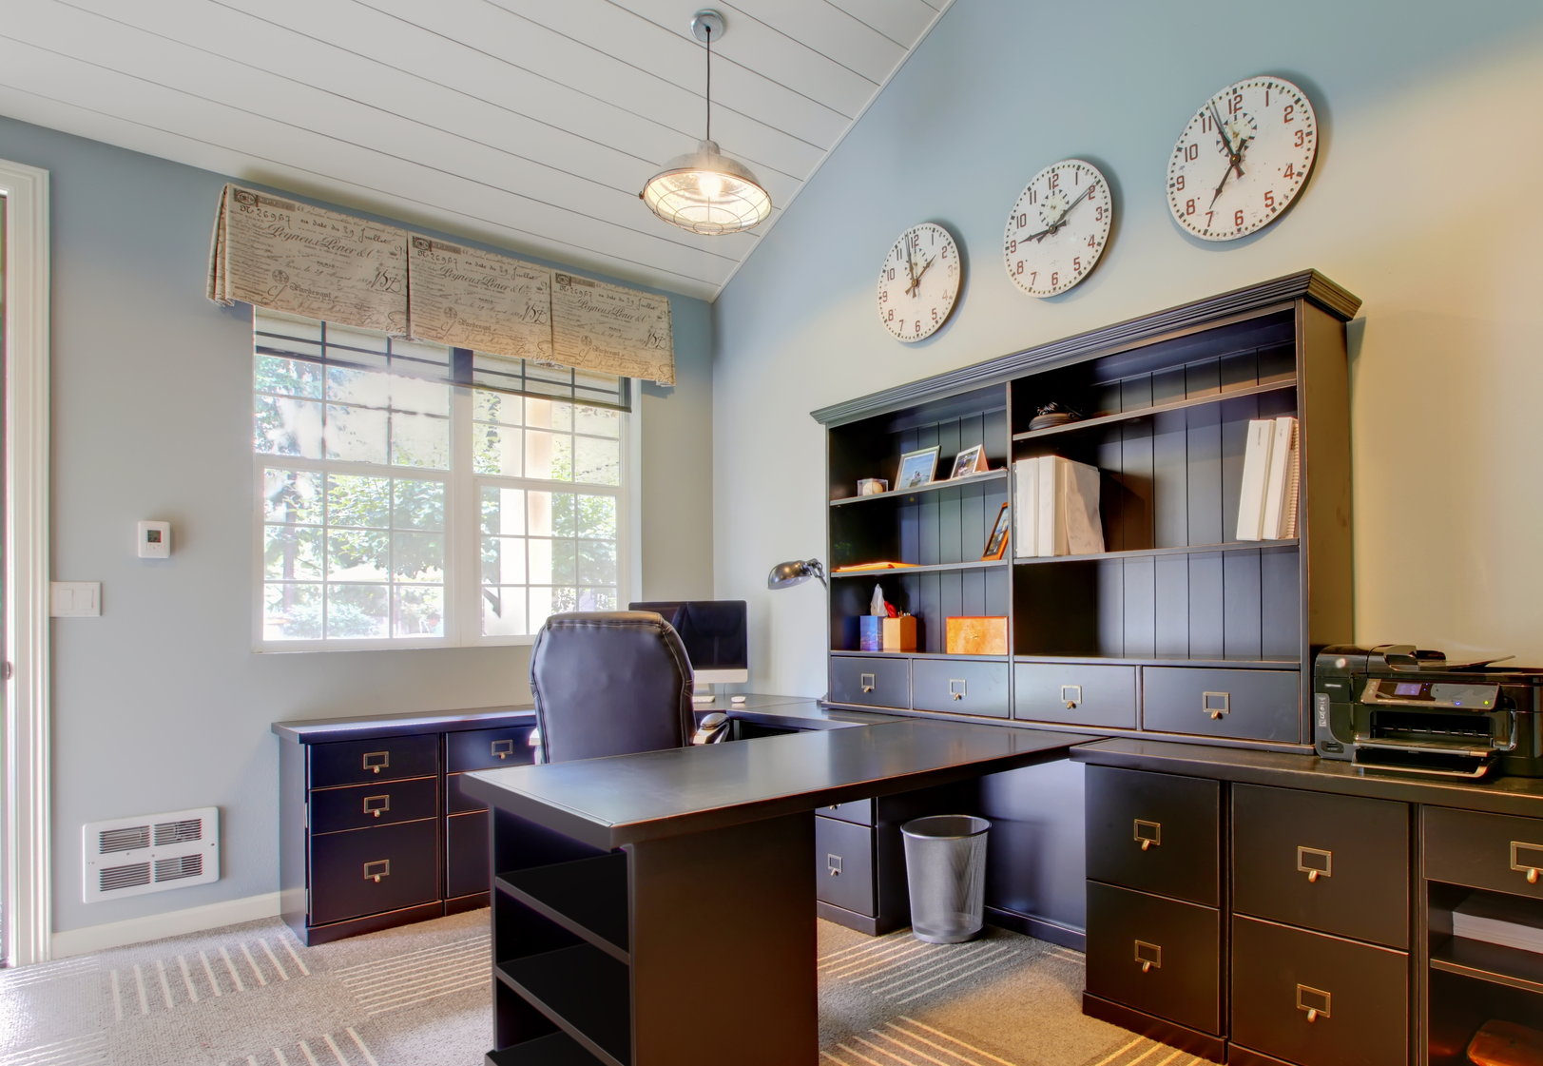
Lighting
Natural light is essential, and it can be maximized by using mirrors and painting the walls with light colors. Make sure your computer screen isn’t affected by direct sunlight and pick a good lighting arrangement for working in the evenings.
Home Office Best Practices
Privacy
An effective home office should be tucked away in a quiet part of the house, out of the way from children or pets that might distract you. This also ensures household noises like blenders or TVs do not interrupt during important conference calls.
Equipment
Computers and connectivity technology are the heart of most work at home set-ups. With this in mind, internet speed becomes a critical aspect of ensuring an effective home office.
There are numerous things to consider when setting up the ideal home office, but here are some of the more important factors
Layout & Organization
Depending on the type of work that you do, you may need to consider more storage for product samples or documents. This can be done with built in storage and innovate layouts.
Ergonomics
It is important to have enough space to be comfortable when working. If you work on your own, make sure your space is big enough for you to move about, stand up and sit back from your desk.

Slide 7
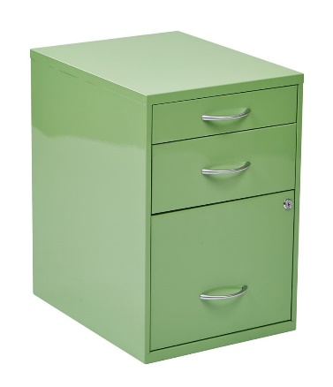
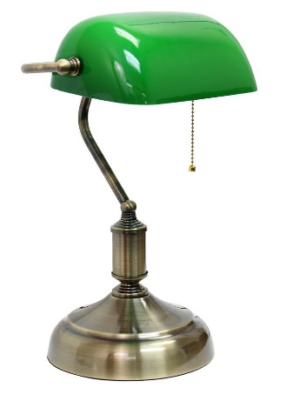

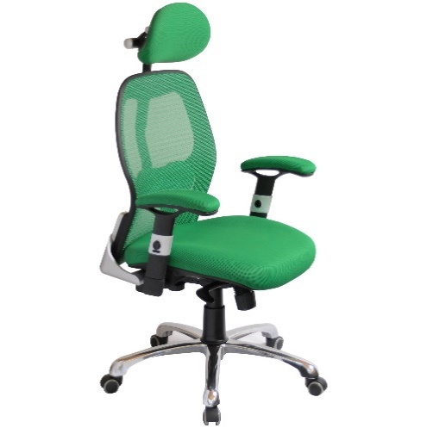
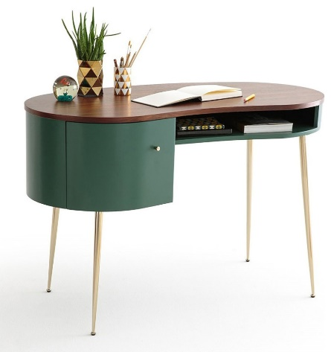

Home Office Done Right
Builders now include home offices as part of new developments and can incorporate
all the best practices to maximize the effectiveness of the space.
Storage & Organization
Privacy
& Sound
Efficient
Space Usage
Lighting
Ergonomics
E-learning
A home office can also double as an e-learning space for children if not needed as a home office or used outside office hours.

Slide 8

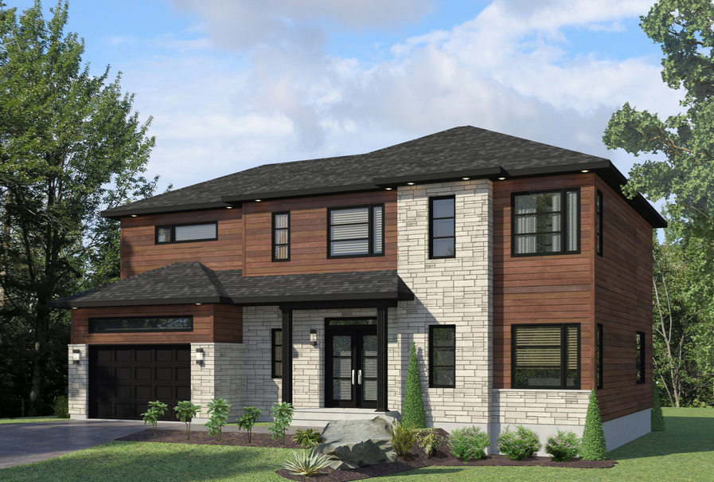
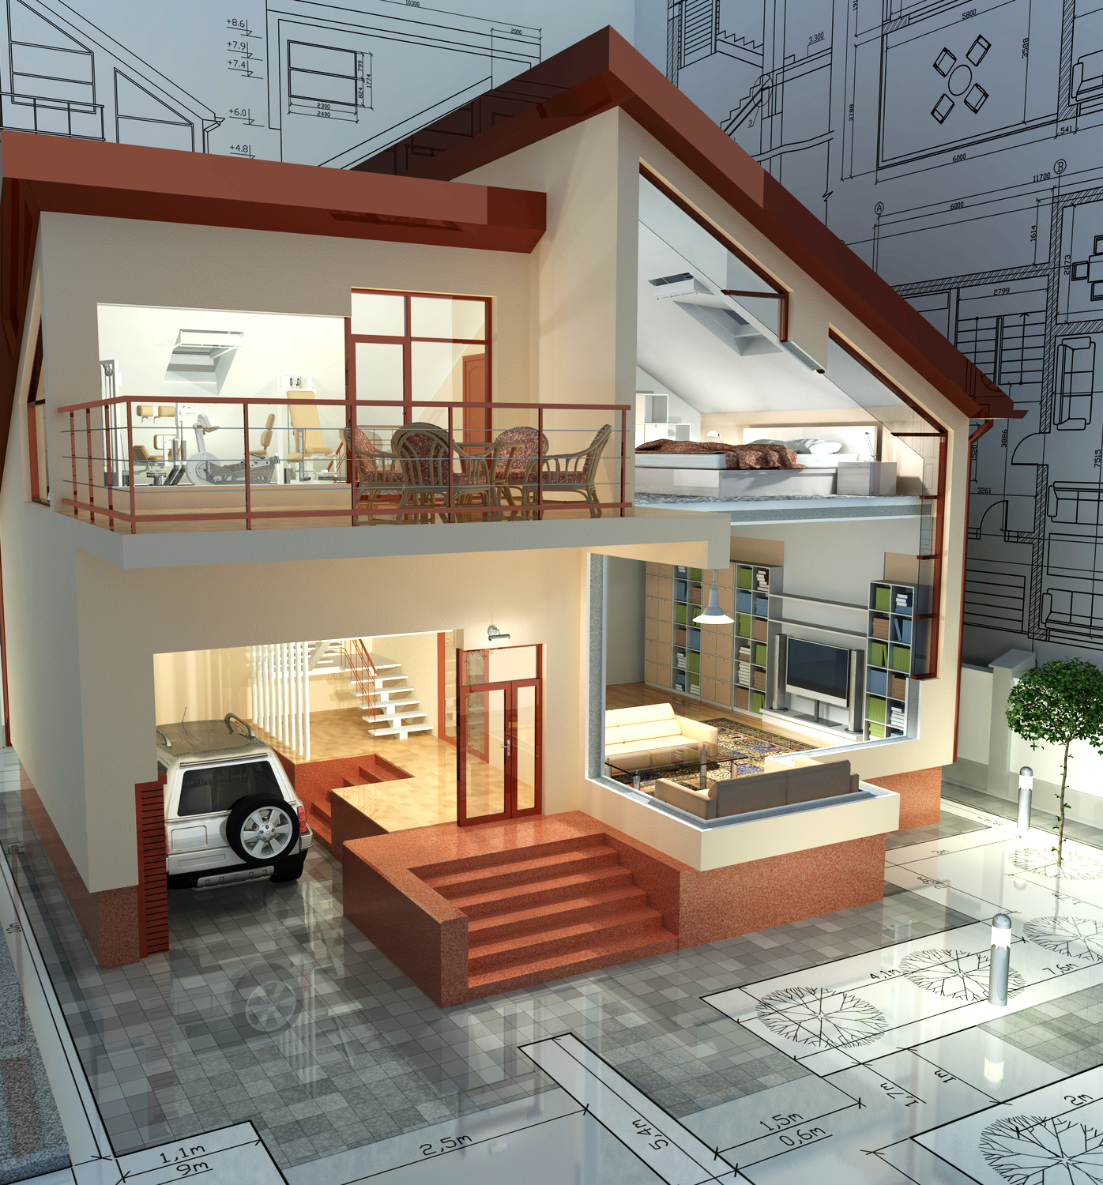
About Riverview Homes
Contact us to learn how you can get the home office of your dreams
We are a Canadian developer committed to building upscale, high quality homes that are always high energy-efficient, LEED certified and ENERGY STAR
We believe in building extraordinary spaces for you to live and work – and are committed to growing a long-term relationship with all our clients by doing so.
Our successful model is focused on a 3-fold approach – great land selection, great home design and great construction that is good for the environment.
Riverview Homes
P.O. Box 470, Iroquois, ON, K0E 1K0 Canada
1.877.337.5557
info@sdwd.ca
www.sdwd.ca
Home Office Customization
We offer 1 or 2 home office spaces as part of our home designs which can further be customized with storage, wiring or lighting to enhance the usability of the space.

